Slide 1
Introduction Structural Equation Modeling

Slide 2

Who Am I?
Ph.D., Marine Science
Virginia Institute of Marine Science
Fields:
Biodiversity & ecosystem function
Seagrass ecosystems
Ecological statistics

Slide 3
My Goals
Familiarize you with the concepts and history behind SEM
Prepare you to construct, evaluate, and interpret SEMs
Focus on practical skills!
Decide if, when, and what kind of SEM is right for you

Slide 4
1. A Brief History of SEM

Slide 5
Overview
What is SEM?
A History Lesson
From ANOVA to SEM

Slide 6
1.1 What is SEM?

Slide 7
1.1 What is SEM?
Structural
Equation
Modeling

Slide 8
1.1 What is SEM?
Structural
Equation
Modeling
There is hypothesized underlying structure to nature…

Slide 9
1.1 What is SEM?
Structural
Equation
Modeling
There is hypothesized underlying structure to nature…
…that can be translated to a series of mathematical equations…

Slide 10
1.1 What is SEM?
Structural
Equation
Modeling
There is hypothesized underlying structure to nature…
…that can be translated to a series of mathematical equations…
…which can be modeled against data to support or refute the proposed structure

Slide 11
1.1 What is SEM? By any other name …
Structural equation modelling (SEM)
(Confirmatory) path analysis
Directed acyclic graph model

Slide 12
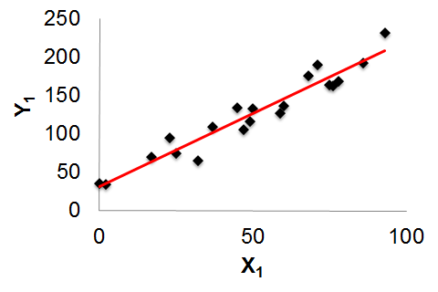
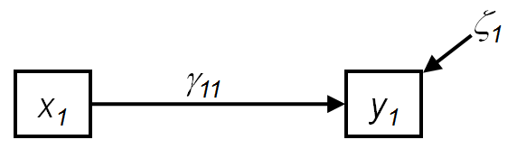
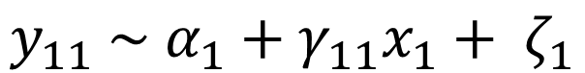
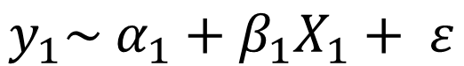
1.1 What is SEM? A graphical approach
Equation form
$$y_{1}\sim {α_{1}+β}_{1}X_{1}+ ε$$
$$y_{11} \sim α_{1}+γ_{11}x_{1}+ ζ_{1}$$
Graphical form

Slide 13
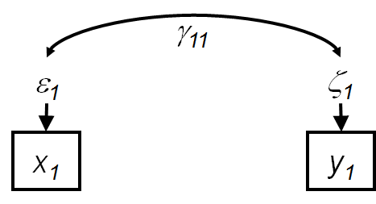
1.1 What is SEM? Directionality

Slide 14
1.1 What is SEM? The elephant in the room
“An equation…can be said to be structural if there exists sufficient evidence from all available sources to support the interpretation that x₁ has a causal effect on y₁.” (Grace, 2006)

Slide 15
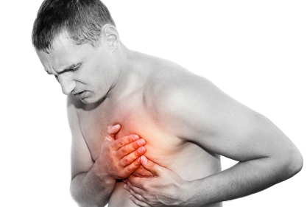
1.1 What is SEM? What is causation?
Key Point #1: SEM assumes that x causes y
Prior observation (a hunch)
Prior statistical models
Prior experimentation
Some or all of the above
Does not assume ultimate causation

Slide 16
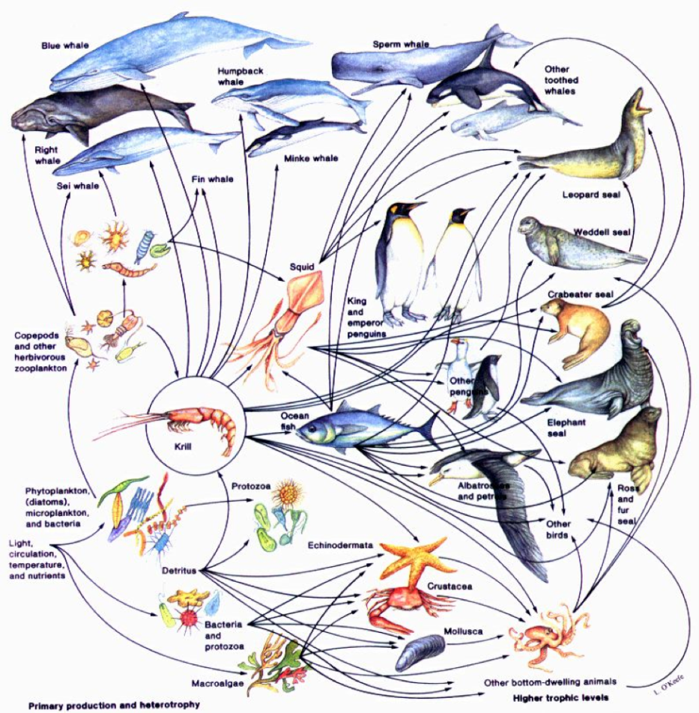
1.1 What is SEM? Nature is complex
vs.

Slide 17
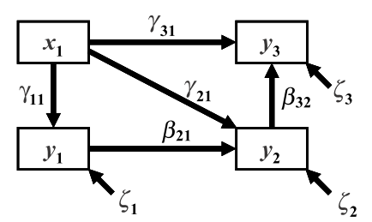
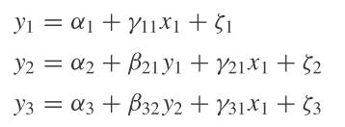
1.1 What is SEM? Incorporating complexity
Graphical model
List of equations

Slide 18
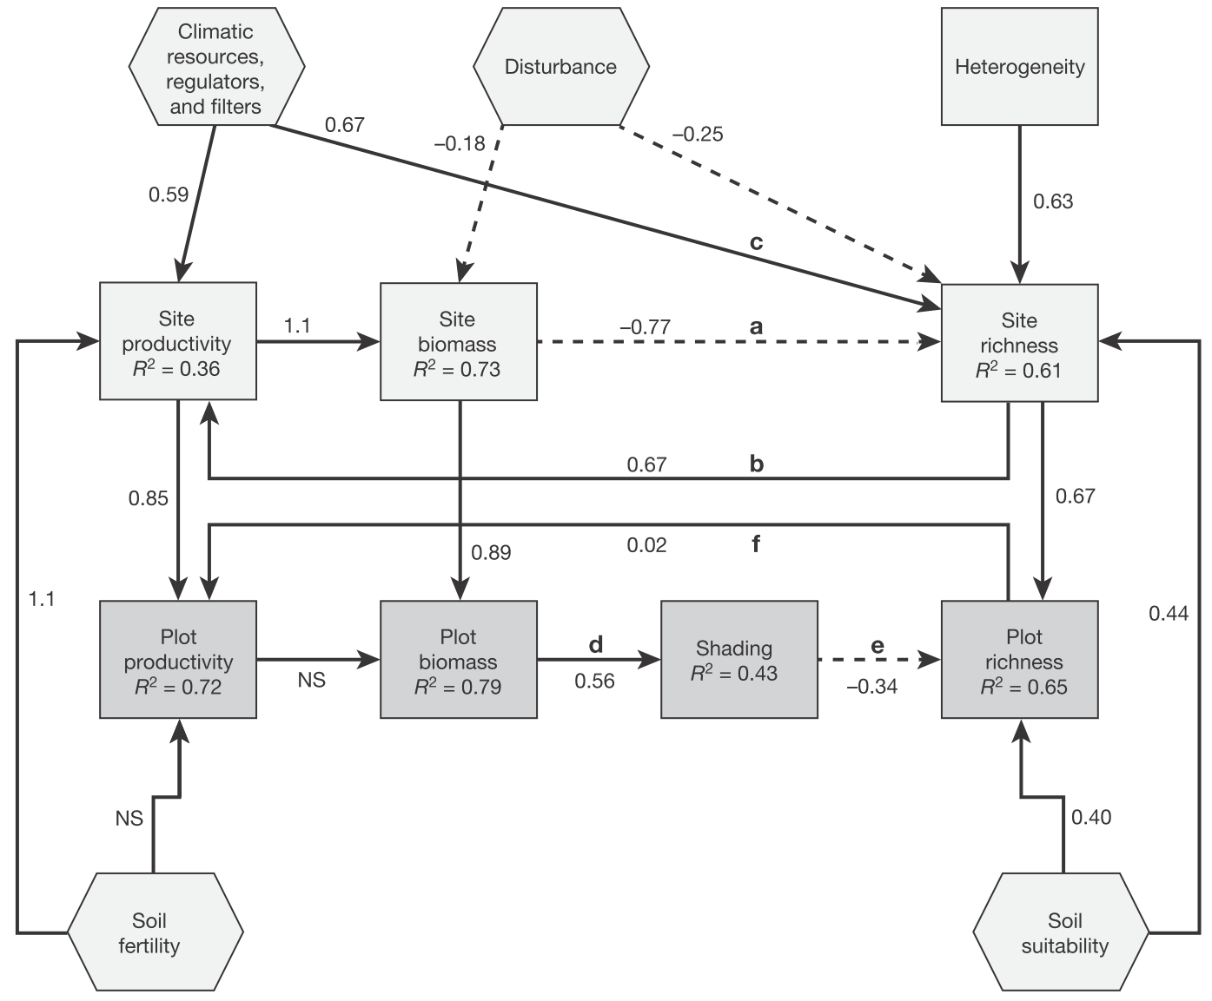
1.1 What is SEM? Building up

Slide 19
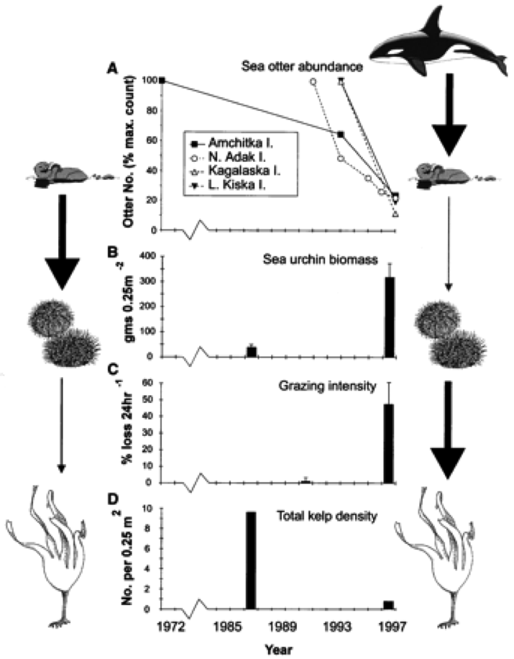
1.1 What is SEM? A complicated network
Key Point #2: By combining inferences across multiple equations, SEM addresses both direct and indirect effects in a system

Slide 20
1.1 What is SEM? Indirect effects
Predator
Diversity
Predator
biomass
Herbivore
Diversity
Herbivore
biomass
Macroalgal
biomass

Slide 21
1.1 What is SEM? Putting it all together
Key Point #1: SEM assumes that x causes y
Key Point #2: By combining inferences across multiple equations, SEM addresses both direct (proximate) and indirect (ultimate) effects in a system

Slide 22
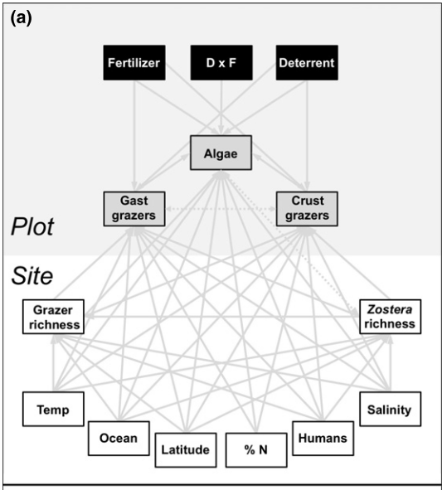

1.1 What is SEM? Reality vs. model
Model
Real world
Real world informs the model, not the other way around!

Slide 23
1.2 A History Lesson

Slide 24
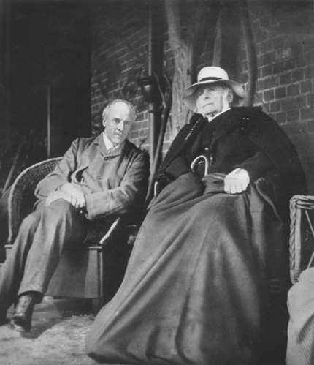
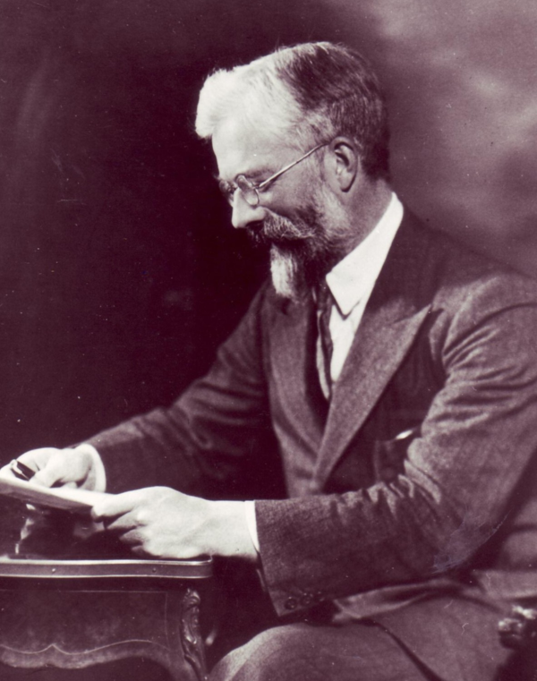
1.2 History. Time warp
Francis Galton
1822-1911
Karl Pearson
1857-1936
Pearson product moment correlation, r
Chi-squared goodness of fit, χ²
ANOVA
Maximum likelihood estimation

Slide 25
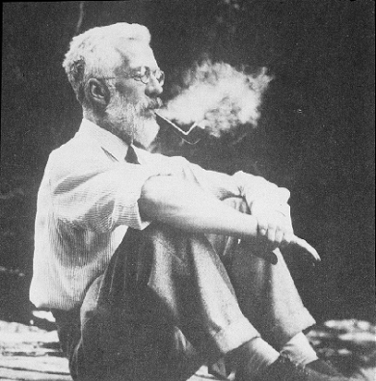
1.2 History. Causation vs. correlation
Smoking → Cancer
Cancer → Smoking
Smoking ← Gene → Cancer

Slide 26
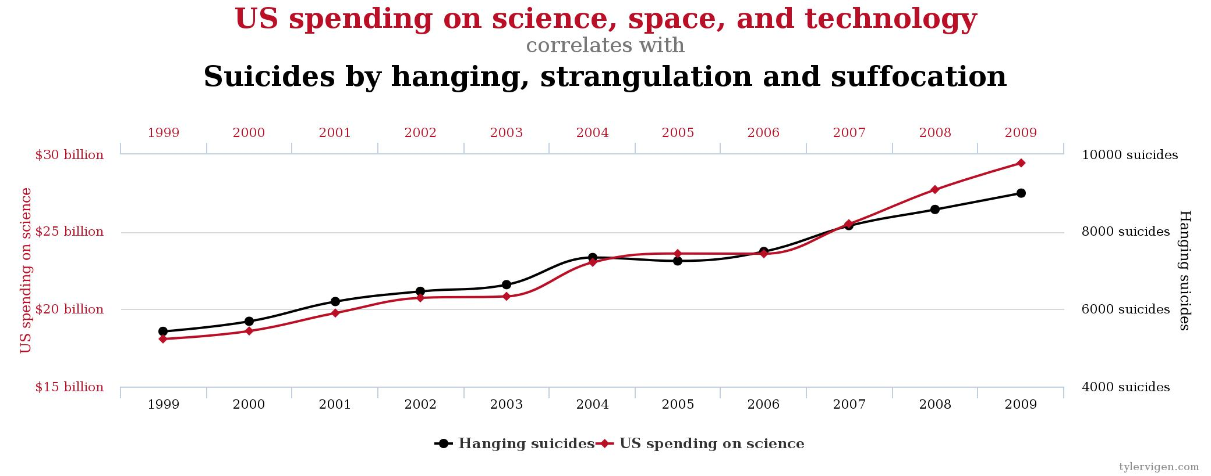
1.2 History. Causation vs. correlation
http://www.tylervigen.com/

Slide 27
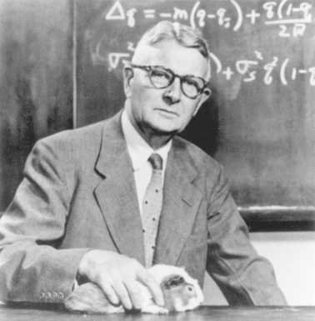
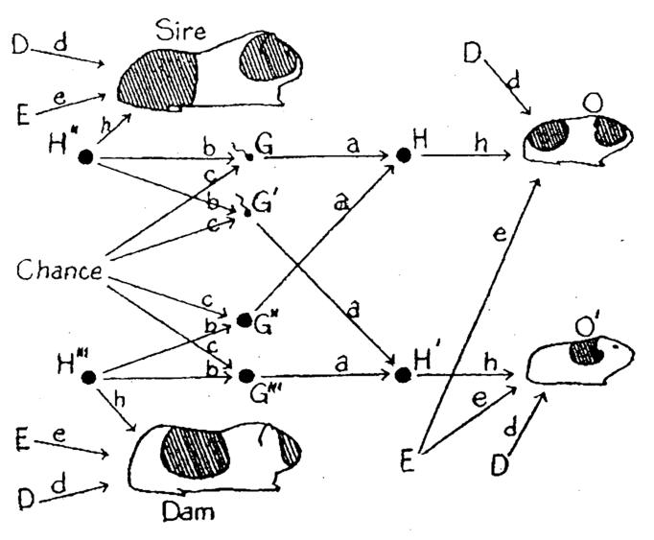
1.2 History. Causation vs. correlation
Sewall Wright
1889-1988
Path analysis

Slide 28
1.2 History. Causation vs. correlation
“The basic fallacy of the method appears to be the assumption that it is possible to set up a priori a comparatively simple graphic system which will truly represent the lines of action of several variables upon each other, and upon a common result. . . . The pure mathematics by which this is shown is apparently faultless in the sense of algebraic manipulation, but it is based upon assumptions which are wholly without warrant from the standpoint of concrete, phenomenal actuality.” (Niles, 1922)
“The writer has never made the preposterous claim that the theory of path coefficients provides a general formula for the deduction of causal relations. He wishes to submit that the combination of knowledge of correlations with knowledge of causal relations, to obtain certain results, is a different thing from the deduction of causal relations from correlations implied by Niles’s statement. Prior knowledge of the causal relations is assumed as a prerequisite in the former case. Whether such knowledge is ever possible seems to be the subject of Niles’s philosophical discussion of the nature of causation.” (Wright, 1923)

Slide 29
1.2 History. Causation vs. correlation
“The basic fallacy of the method appears to be the assumption that it is possible to set up a priori a comparatively simple graphic system which will truly represent the lines of action of several variables upon each other, and upon a common result. . . . The pure mathematics by which this is shown is apparently faultless in the sense of algebraic manipulation, but it is based upon assumptions which are wholly without warrant from the standpoint of concrete, phenomenal actuality.” (Niles, 1922)
“The writer has never made the preposterous claim that the theory of path coefficients provides a general formula for the deduction of causal relations. He wishes to submit that the combination of knowledge of correlations with knowledge of causal relations, to obtain certain results, is a different thing from the deduction of causal relations from correlations implied by Niles’s statement. Prior knowledge of the causal relations is assumed as a prerequisite in the former case. Whether such knowledge is ever possible seems to be the subject of Niles’s philosophical discussion of the nature of causation.” (Wright, 1923)

Slide 30
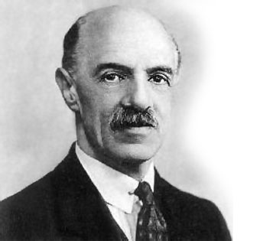
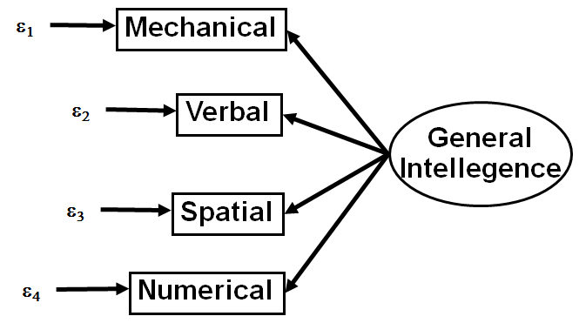
1.2 History. Factor Analysis
Charles Spearman
1863-1945

Slide 31
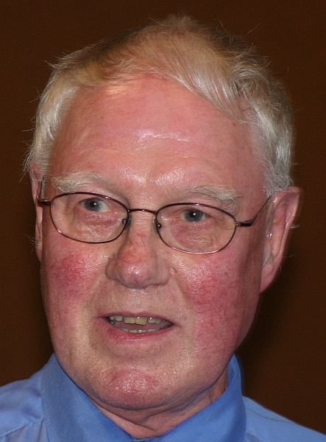
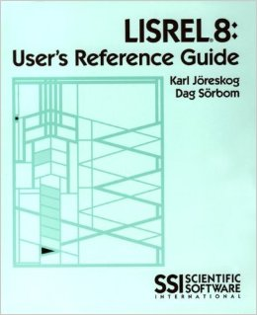
1.2 History. 2nd Generation SEM
Karl Jöreskog
1935-
LISREL = combine path and factor analysis
Model fit using covariance and ML estimation
Assess and compare fit of multivariate model

Slide 32
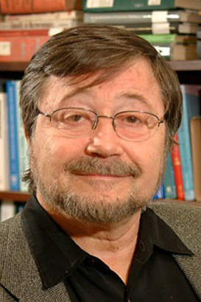

1.2 History. 3rd Generation SEM
Judea Pearl
1936-
Unite SEM with graph theory
Causality is central
Flexible methods with piecewise approach

Slide 33
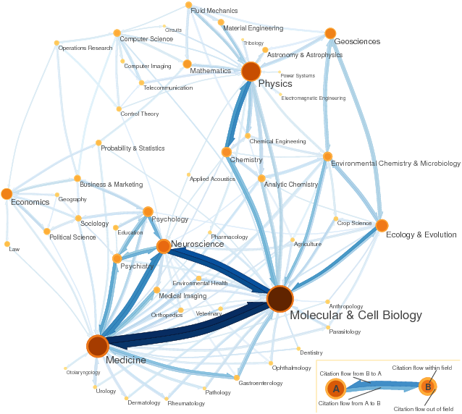
1.2 History. SEM and Ecology

Slide 34
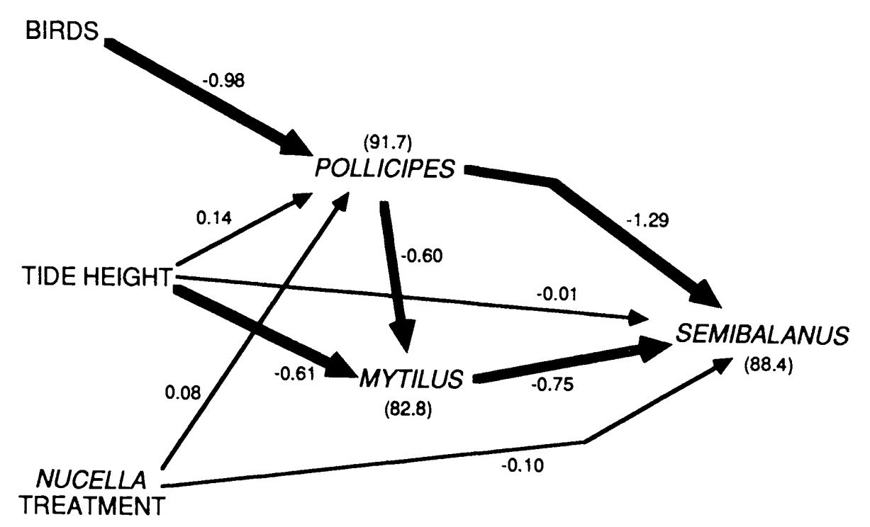
1.2 History. SEM and Ecology
Wootton (1994) Ecology

Slide 35
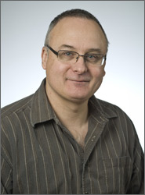
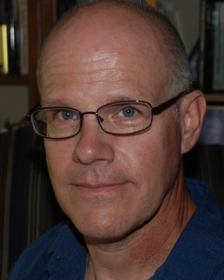

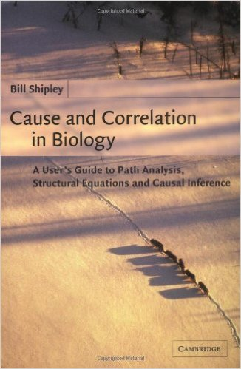

1.2 History. SEM and Ecology
Jarrett Byrnes
Bill Shipley
Jim Grace
2002
2006

Slide 36
1.3 From ANOVA to SEM

Slide 37
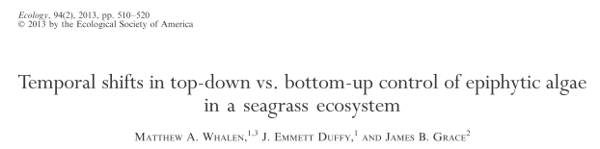


1.3 From ANOVA to SEM. Whalen et al. 2013

Slide 38
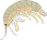


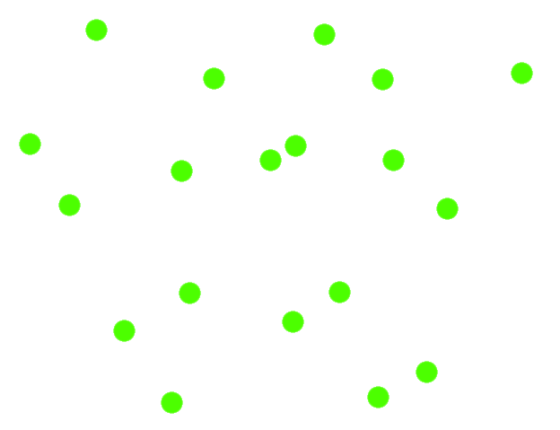
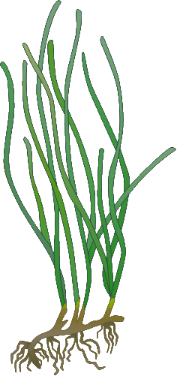
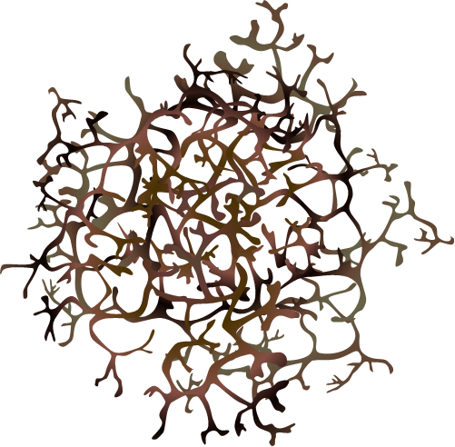
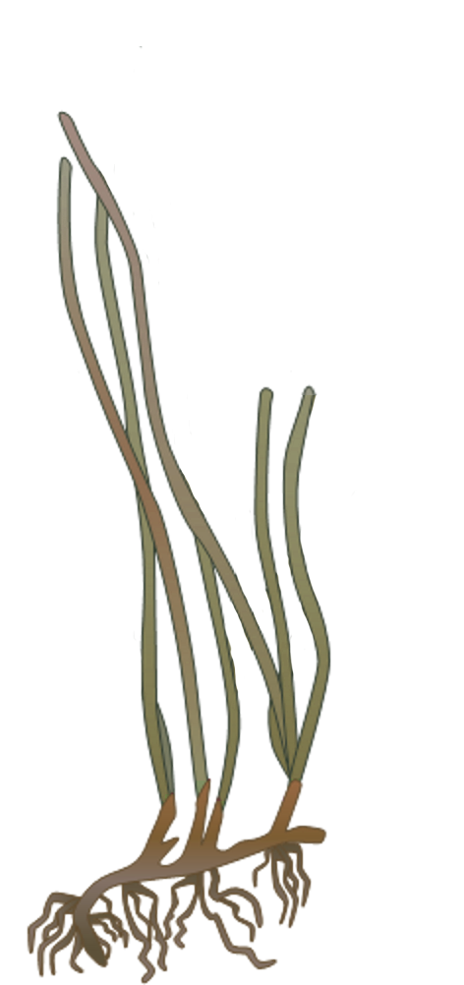

1.3 From ANOVA to SEM. Seagrass systems
Notes:
The existing paradigm, at least in temperate eelgrass beds, is that runoff and other drivers of eutrophication would quickly cause the eelgrass to become overgrown with fouling micro- and macroalgae an ddie. However, epifauna are excellent at grazing down algae, allowing eelgrass access to light and nutrients needed to survive and grow.

Slide 41
1.3 From ANOVA to SEM. Experimental Design
What are the relative influence of top-down vs.
bottom-up control in controlling seagrass ecosystems?
- Nutrients +
Control
(D-N-)
+ Nutrients
(D-N+)
- Deterrent +
+ Deterrent
(D+N-)
+ Deterrent
+ Nutrients
(D+N+)

Slide 42
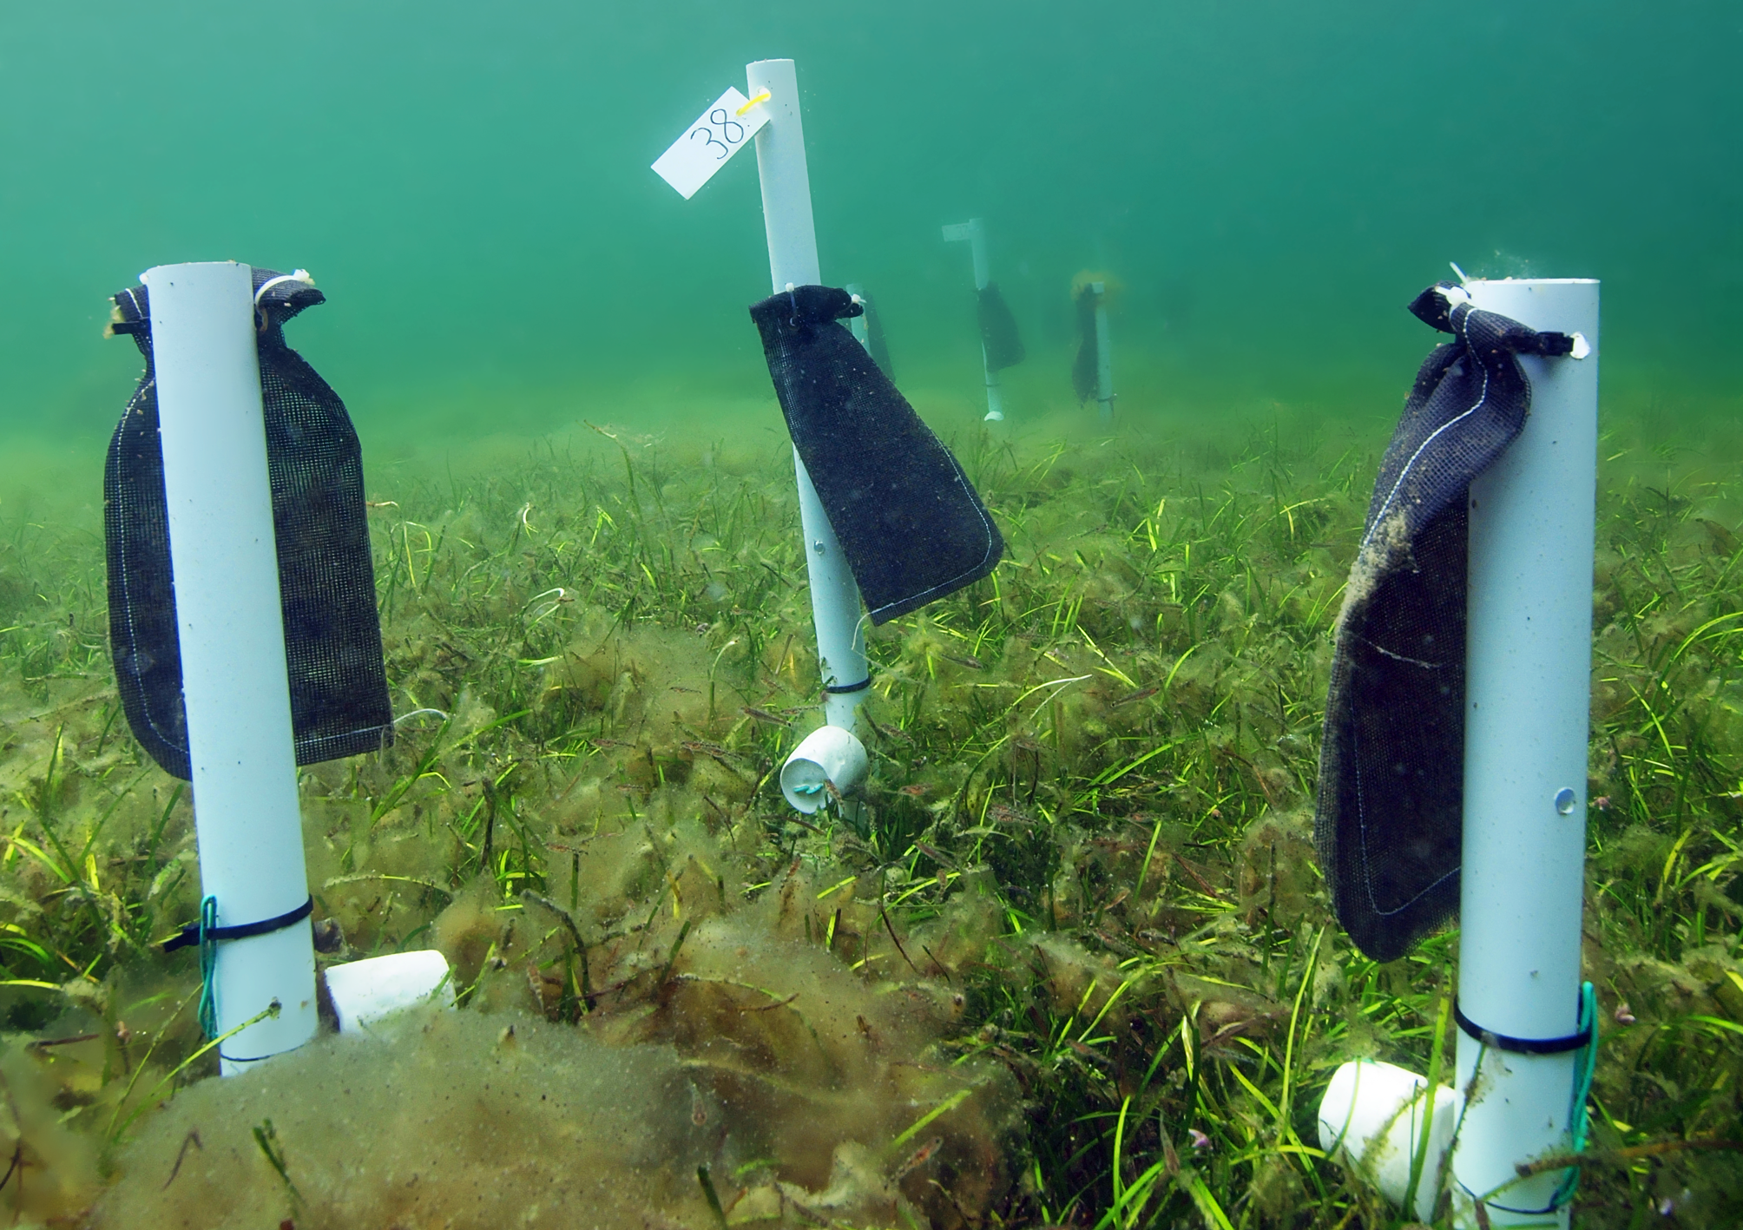
1.3 From ANOVA to SEM. Whalen et al. 2013

Slide 43
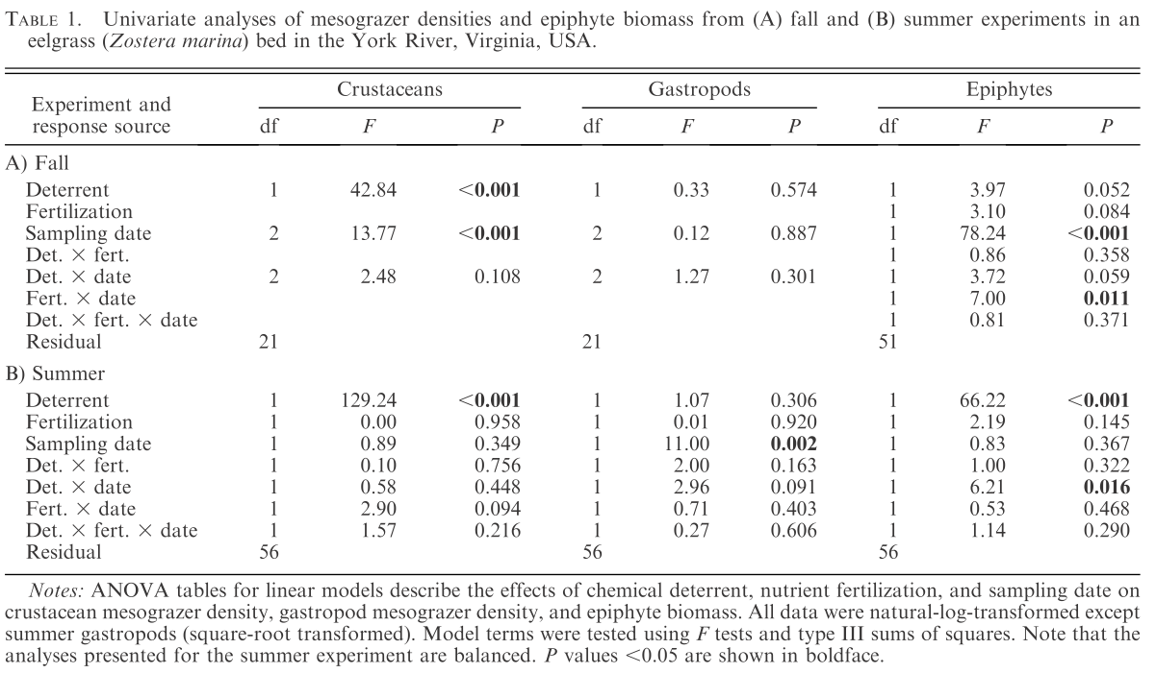
1.3 From ANOVA to SEM. Whalen et al. 2013
DEATH BY F-TABLES!

Slide 44
1.3 From ANOVA to SEM. ANOVA
Epiphytes ~ Pesticide
Pesticide
(0/1)
Pesticide increases epiphytes
0.72
Epiphytes
R² = 0.51
ε

Slide 45
1.3 From ANOVA to SEM. ANCOVA
Epiphytes ~ Pesticide + Macroalgae + Seagrass
Pesticide
(0/1)
Pesticide increases epiphytes more than habitat (substrate) increases them
0.72
-0.13
0.24
Macroalgae
Epiphytes
R² = 0.59
Seagrass
ε
0.14

Slide 46
1.3 From ANOVA to SEM. Mediation
Pesticide reduces amphipods, which in turn releases epiphytes from grazing. Macroalgae and seagrass provides habitat for amphipods and substrate for epiphytes, promoting grazing.
Pesticide
(0/1)
-0.75
Gammarids
R² = 0.75
0.42
0.15
-0.79
Macroalgae
Epiphytes
R² = 0.59
Seagrass
0.18
0.35
ε
-0.14

Slide 47
1.3 From ANOVA to SEM. Mediation x2
Pesticide
(0/1)
-0.75
0.15
-0.40
Caprellids
R² = 0.38
Gammarids
R² = 0.75
0.42
0.46
-0.64
-0.33
Macroalgae
Epiphytes
R² = 0.66
Seagrass
0.28
0.38
ε
-0.14

Slide 48
1.3 From ANOVA to SEM. Increasing inference
Pesticide reduces epiphytes
Pesticide increases epiphytes more than habitat (substrate) increases them
ANOVA
Pesticide reduces amphipods, which in turn releases epiphytes from grazing. Macroalgae and seagrass provides habitat for amphipods and substrate for epiphytes, promoting grazing.
ANCOVA
Pesticide reduces gammarid and caprellid amphipods, which in turn releases epiphytes from grazing. Gammarids appear to control epiphytes in this system. Macroalgae provides habitat for amphipods, promoting grazing, while eelgrass provides substrate for epiphytes.
SEM
Full SEM

Slide 49
1.3 From ANOVA to SEM. Increasing inference
Teases out complex relationships
Identification and comparison of direct vs. indirect effects & potential mediators
Precise mechanistic explanations

Slide 50


Slide 51
2. Terms and Definitions

Slide 52
2.1 Terms & Definitions.
Structural equation model = observed, latent, composite
Direct acyclic graph (DAG) = observed
Path diagram = observed

Slide 53
2.1 Terms & Definitions.
Exogenous variable = independent variable, predictor
x₁

Slide 54
2.1 Terms & Definitions.
Exogenous variable
Endogenous variable =
dependent variable,
response
x₁
y₂
y₁

Slide 55
2.1 Terms & Definitions.
Exogenous variable
Endogenous variable
x₁
y₂
y₁
y₁
?
Endogenous variable

Slide 56
2.1 Terms & Definitions.
Assumes linear relationships!
Exogenous variable
Path coefficients
Endogenous variable
γ₂₁
x₁
y₂
γ₁₁
β₂₁
y₁
γ (gamma) used to represent effect of exogenous on endogenous.
β (beta) used to represent effect of endogenous on endogenous.
Endogenous variable

Slide 57
2.1 Terms & Definitions.
Exogenous variable
Path coefficients
Endogenous variable
γ₂₁
x₁
y₂
γ₁₁
β₂₁
ζ₂
y₁
ζ₁
Unexplained variation =
error
Endogenous variable

Slide 58
2.1 Terms & Definitions.
Exogenous variable
Path coefficients
Endogenous variable
x₁
y₂
γ₁₁
Direct effect
β₂₁
ζ₂
y₁
ζ₁
Unexplained variation
Endogenous variable

Slide 59
2.1 Terms & Definitions.
Path coefficients
Endogenous variable
γ₂₁
x₁
y₂
γ₁₁
Direct effect
β₂₁
ζ₂
y₁
Indirect effect, x₁ → y₁ → y₂
ζ₁
Unexplained variation
Endogenous variable

Slide 60
2.1 Terms & Definitions.
Unexplained correlation
x₁
γ₁₁
y₁
ζ₁
x₂
γ₂₁

Slide 61
2.1 Terms & Definitions.
δ₁
x₁
γ₁₁
y₁
ζ₁
δ₂
x₂
γ₂₁
Uncertain causal relationship (x₁ → x₂ , or x₂ → x₁ ?)
Common driver (correlated error)
Convention: show correlation between endogenous errors but not exogenous – still there, though!

